Slide 1

Digit Recognition using Convolutional Neural Networks in R

Slide 2
Introduction to Digit Recognition
What is Digit Recognition?
The process of automatically identifying handwritten or printed digits from images.
Real-World Implementations
From bank check processing to automated postal sorting, digit recognition plays a crucial role in various industries.

Slide 3

Importance of Digit Recognition in Real-World Applications
Financial Transactions
Processing checks, recognizing amounts on receipts, and automating banking systems.
Document Processing
Automating data entry, extracting information from invoices, and recognizing numbers in forms.
Image Analysis
Analyzing images for medical diagnoses, identifying objects in photos, and recognizing license plates.

Slide 4
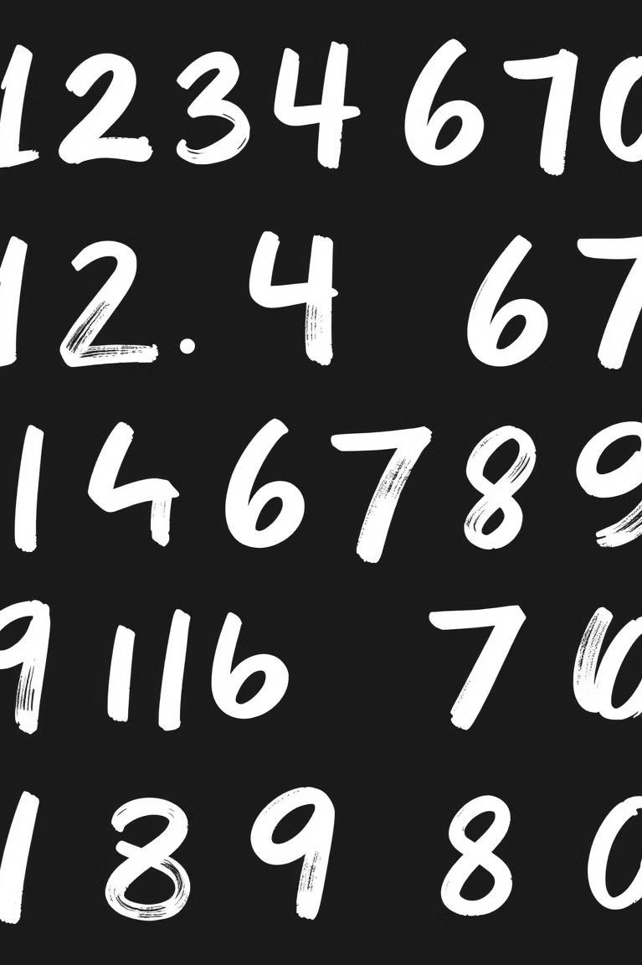
Dataset: MNIST Handwritten Digits
MNIST Database
A widely used dataset containing images of handwritten digits 0-9.
C0,000 Training Images
The dataset is split into training and test sets, allowing for robust model evaluation.
10,000 Test Images
The test set provides an independent measure of the model's performance on unseen data.

Slide 5

Convolutional Neural Network Architecture in R
Convolutional Layers
Extract features by convolving filters with the input image.
Pooling Layers
Downsample the feature maps, reducing the number of parameters and preventing overfitting.
Activation Functions
Introduce non-linearity into the network, allowing it to learn complex patterns.
Fully Connected Layers
Connect all neurons from the previous layer to all neurons in the current layer, allowing for a global understanding of features.

Slide 6
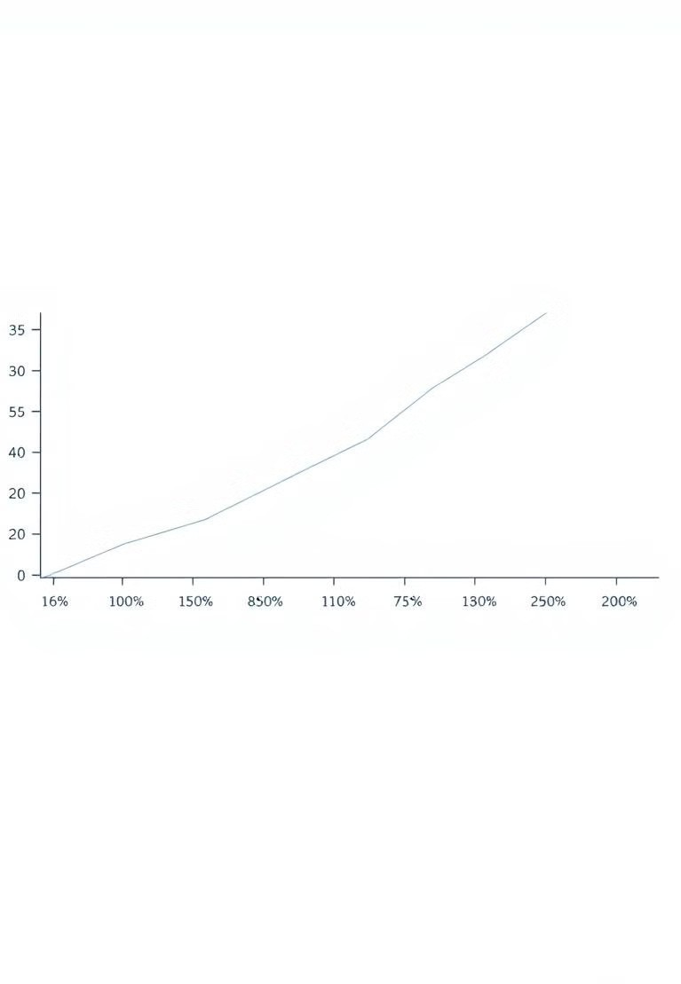
Model Training and Optimization
1
The model was trained using the MNIST dataset, optimizing its parameters to achieve the highest accuracy.
2
Gradient descent algorithms were employed to adjust the weights and biases of the network, minimizing the error.
3
Regularization techniques were used to prevent overfitting, ensuring the model generalizes well to new data.

Slide 7
Achieving 85% Accuracy
Accuracy
1
85%
The model achieved an impressive 85% accuracy on the MNIST test set.
2
Performance
The model demonstrated robust performance on unseen digits, showcasing its ability to generalize well.
3

Slide 8
Conclusion: The Future of Digit Recognition
1
Digit Recognition in R
Real-World Impact
Digit recognition has the potential to revolutionize industries, making processes more efficient and automated.
2
Future Directions
Further research and development in CNNs can lead to even higher accuracy and broader applications.
3

